Slide 1
Zodiacal Light
Scientific Possibilities for Observations from Space Probes
Bill Reach
Associate Director for Science
Stratospheric Observatory for Infrared Astronomy

Slide 2
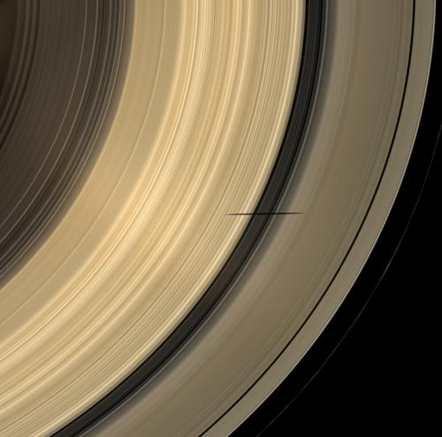
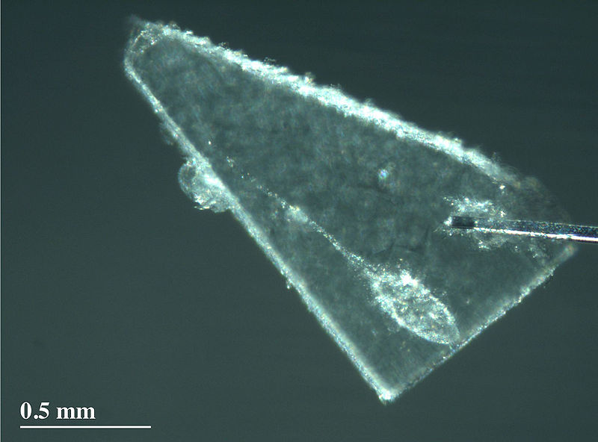
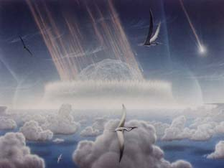
Why Study the Smaller Bodies?
Tracer of gravitational potential
Sample of material from solar nebula and major bodies
Transport of material and construction of major bodies

Slide 3
Asteroidal and Cometary Planetsesimals in the Solar Nebula
Solids devolatilized
Icy planetesimals
5 AU
H₂O ice
Notes:
Distinction between comet and asteroid before planets form: solid water condensed onto grains.
EARTH: formed from devolatilized rocks.

Slide 4
Cometary Material in Present
Solar System
Zodiacal cloud
Accreted nebular gas
Cometary+asteroidal veneer
Cometary moon
Heavy core
Cometary core
Terrestrial planets & asteroids
Gas Giants
Ice Giants
Kuiper Belt
Notes:
Outer planet formation perturbs comets, sends them to Oort cloud and inner Sol System.
Inner planets would have no volatiles unless delivered from outer Sol Sys (but maybe outer asteroid belt).
Cometary material deposited as interplanetary dust 1e5 times more dense than now, or unaltered material fromlarge impacts.

Slide 5
Zodiacal Light
Interstellar Medium
Comet 2P/Encke
Karin asteroid family debris bands
Comet 10P/Tempel 2
Veritas asteroid family debris bands
Comet 65P/Gunn

Slide 6
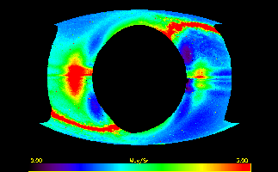
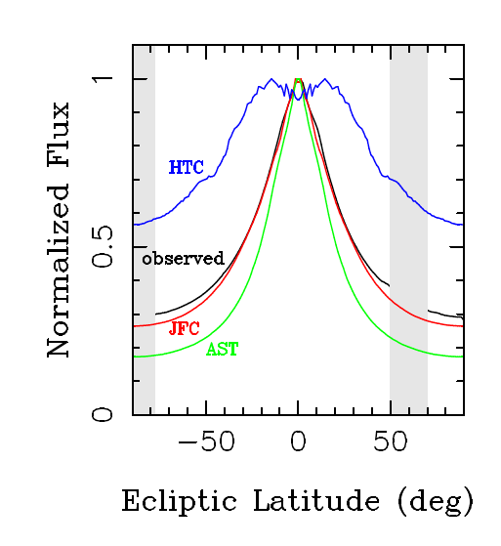
Infrared Zodiacal Light (view from 1 AU)
dominates sky brightness from 1 to 100 microns
Structures include bands, warp, terrestrial anisotropy
  From width of the zodiacal cloud, >90% Jupiter family comets (Nesvorny et al 2009)

Slide 7
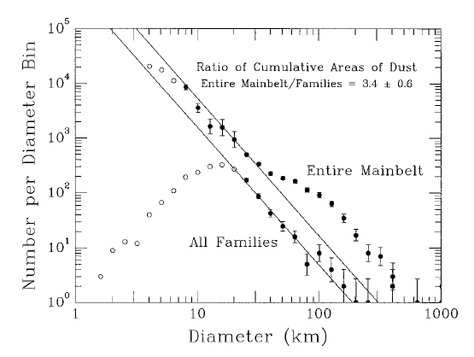
Asteroids: family VS entire

Slide 8
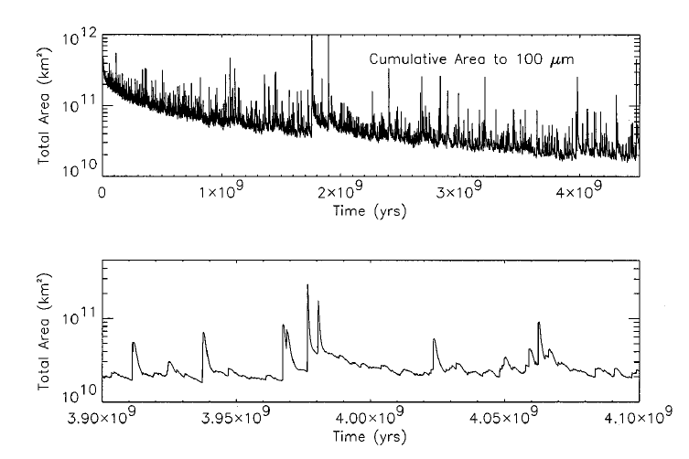
Asteroidal Dust History

Slide 9
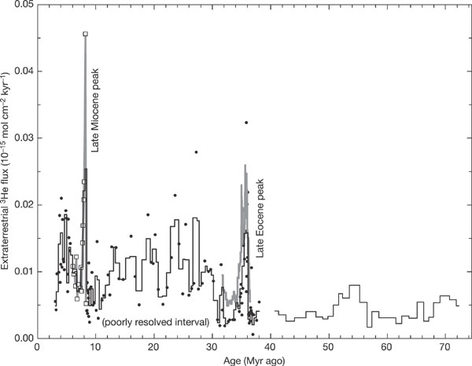
Influx to Earth
Considered to be asteroidal (low velocity)
Seafloor sediment contains ³He from IDPs, enhancement in Miocene tied to asteroid disruption that formed Veritas family (Farley+ 2006, Science)
Intro: Why small bodies
Cometary contribution to meteorites considered elusive, but possibly most IDPs and some carbonaceous chondrites are cometary (cf. Nesvorny et al 2010)

Slide 10
Recent Asteroid Collisions
Age | Source | Feature | Reference
50-250 kyr | 1999 YC2 |  | Nesvorny (2006 AJ 132, 1950)
220±2 kyr | Emilkowalski
300-800 kyr | Lucasavin
450 kyr | Datura | trail? | Nesvorny (2006 Sci 312, 1490)
<5 Myr | Beagle | 1.4°band | Nesvorny (2008 ApJ 679, L143)
5.0±0.2 Myr | Karin | 2.1°band | Nesvorny (2006 Icarus 183, 296)
8.3±0.5 Myr | Veritas | 9.3°band | Nesvorny (2003 ApJ 591, 486) Farley (2006 Nature 432, 295)
~10 Myr | Semajoki | 17°band | Nesvorny (2003 ApJ 591, 486)
35 Myr (Eocene) | Comet shower | Chesapeake Bay, Popigai crater | Farley (1998 Sci 280, 1250)
Intro: Why small bodies

Slide 11
Observations from Spaceprobe
From fixed platform, only measure integrals along line of sight, not readily inverted
Inner zodiacal light best measured by Helios spaceprobes, 0.3-1 AU eccentric orbit photopolarimeter (Leinert et al.) in 1970’s
Azimuthal asymmetries near 1 AU probed by Spitzer (new; next slides)
Zodiacal light only measured out to 3.5 AU by Pioneer 10
Prime real estate still available outside 3.5 AU, to measure “outer zodiacal light”

Slide 12
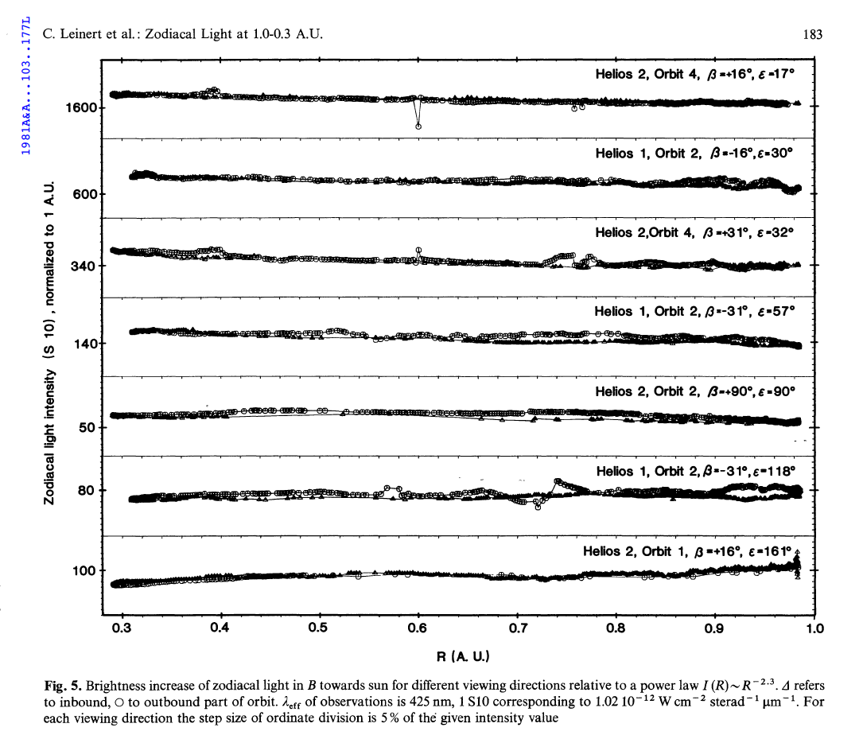

Slide 13
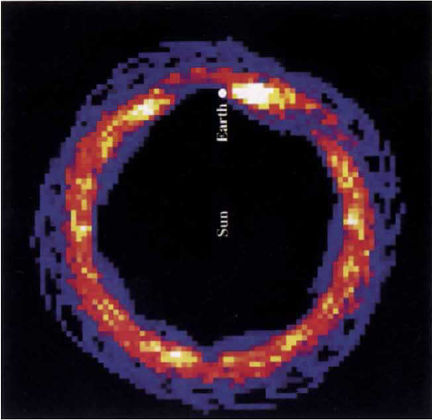
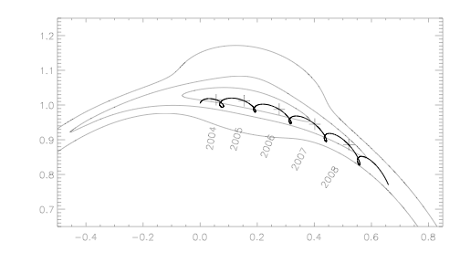
Resonant structures in Zodiacal Cloud
Smooth cloud traces mean orbital elements
  Node randomized by Jupiter in 10⁶ yr so only secular long-time-averaged perturbations survive
Resonant effects in comoving frame with planet
Spitzer Earth Ring experiment
Frame comoving with Earth
Contours of the COBE/DIRBE zodiacal cloud model
Trajectory of Spitzer (thick) with crosses every year
Able to probe azimuthal structure of zoiacal cloud

Slide 14
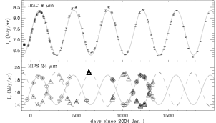
Observed brightness of North Pole
Infrared/Zodiacal Light
Sinusoidal variation due to inclination of zodiacal plane, and eccentricity of orbits

Slide 15
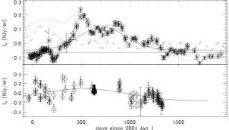
observed MINUS sinusoid
Residual variation due to longitudinal asymmetry of zodiacal cloud

Slide 16
Observations from Spaceprobe
From fixed platform, only measure integrals along line of sight, not readily inverted
Inner zodiacal light best measured by Helios spaceprobes, 0.3-1 AU eccentric orbit photopolarimeter (Leinert et al.) in 1970’s
Azimuthal asymmetries near 1 AU probed by Spitzer (new; next slides)
Zodiacal light only measured out to 3.5 AU by Pioneer 10
Prime real estate still available outside 3.5 AU, to measure “outer zodiacal light”

Slide 17
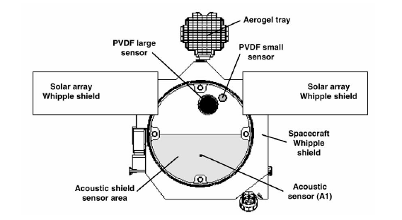
STARDUST in situ particle detection
Dust Flux Monitor Instrument
  Impacts onto polarized film generate current pulse
Acoustic sensor
  piezoelectric crystals respond to impacts onto shield
Radio Doppler and attitude control
  Responded to large particle ~30 mg, 15 s before close approach
  Similar large particles jogged Giotto and destroyed its camera

Slide 18
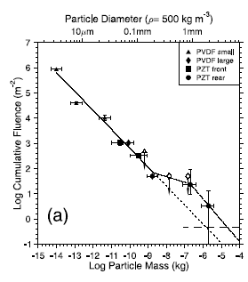
Particle Size Distribution
For power-law n(<m)~m^{-α}
  Most mass in largest particles if α<1
  Surface area in large particles if α<2/3
Halley & Wild2 →α=0.75-0.88
  Applies to m<1 µg
  Mass in large, area in small
Large particle excess
  Double power-law fit
Radio Doppler
  20-40 mg particle shifted attitude
  (Anderson et al 2004 JGRE 109) a~2 mm
Green et al 2004 JGRE 109

Slide 19
Application to Stardust data
Mass ratio
  Observe: m_{max}/m₁>100, m₂/m₁ ~ 300
  → M₂/M₁~600
  Bulk of mass in “bump”
Area ratio:
  Observe: m₁/m_{min}>10⁶
  → A₂/A₁<7
  Significant area in “bump”
  Coma due to large+small particles

Slide 20
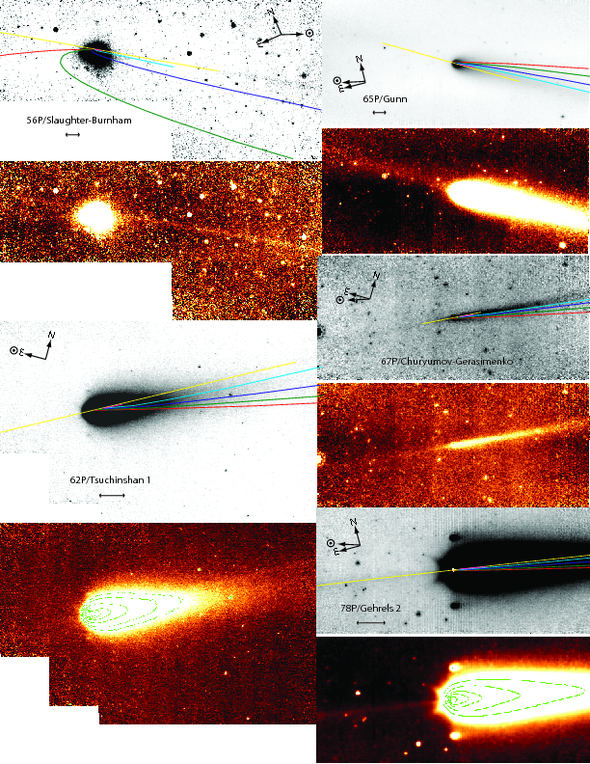
Cometary dust production
Reach et al. 2007 Icarus 191, 298

Slide 21
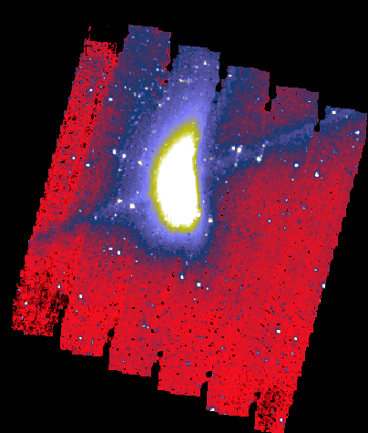
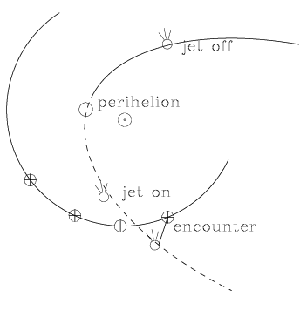
2P/Encke: ISOCAM
10⁵ km
July 14, 1997
close approach to Earth (Δ=0.25, R=1.15 AU)
Post-perihelion
wavelength: 12μm

Slide 22
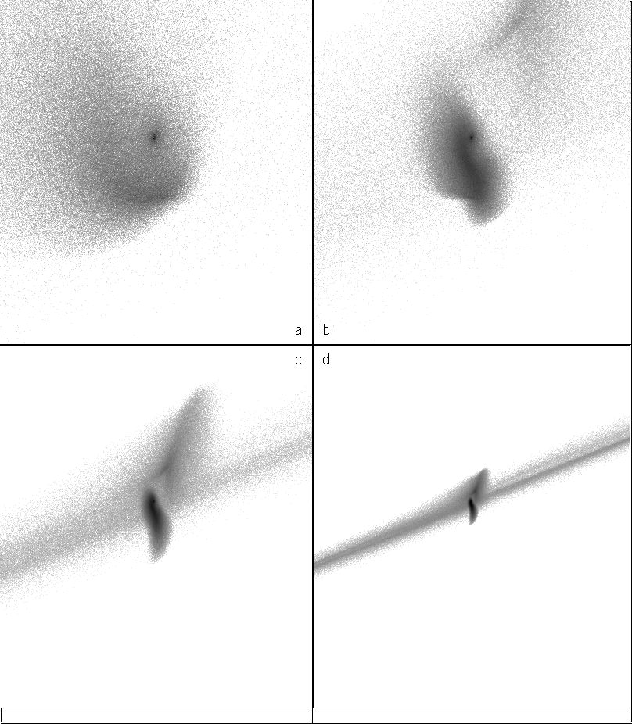
Trail and coma versus particle size
Model: particles ejected since previous aphelion
ISOCAM geometry
→
The trail is due to cm-sized particles
Even the “coma” is due to mm sized particles
100 µm
1 mm
1 cm
10 cm

Slide 23
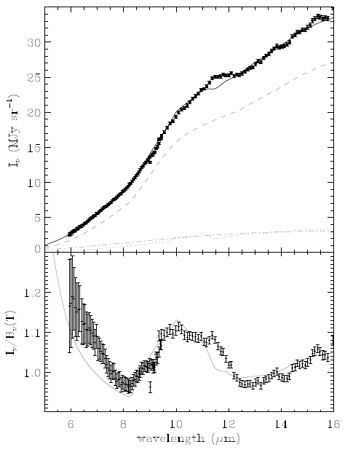
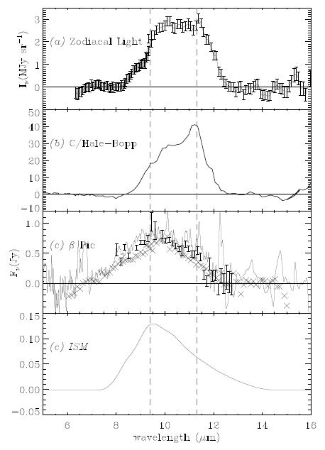
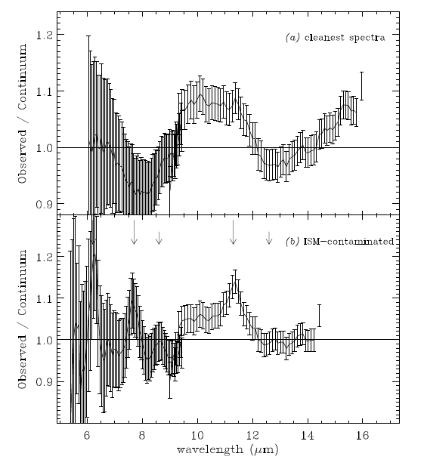
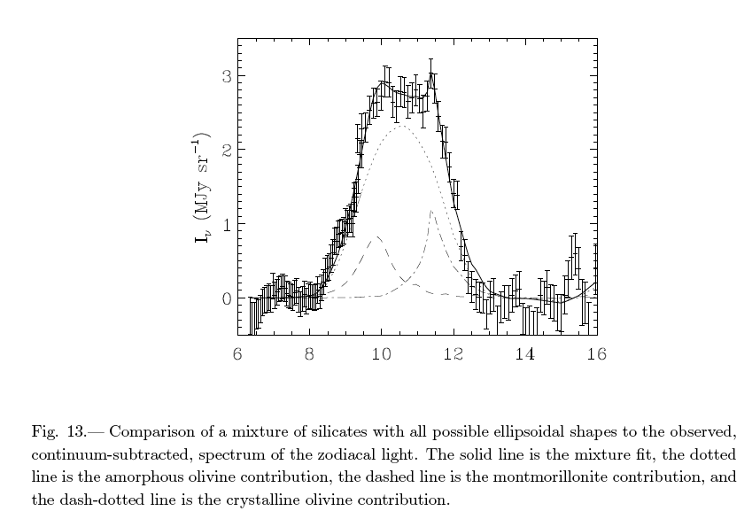
Zody Light Spectra from ISO – Small But Finite Silicate Emission Feature.
(Reach et al. 2003)
Olivine
Pure Zody w/
~10% Silicate
Feature (mostly
large grains)
But: Need to update spectral analysis for Deep Impact, STARDUST, dynamical, & Spitzer lessons learned re: cometary & asteroidal dust.
Dust
Evolution
Pyroxene
“Pure” Zody
See also:
Messenger & Keller -
(IPD like Hale-Bopp)
New CIBER Results-
Zody Refl. Like S-Type Asteroids
Nesvorny IRAS Fitting -
>90% of IPD input is from JFCs
ISM signal correlates
w/ PAH features
Best Decomposition = ~20% Asteroid +80% Comet

Slide 24
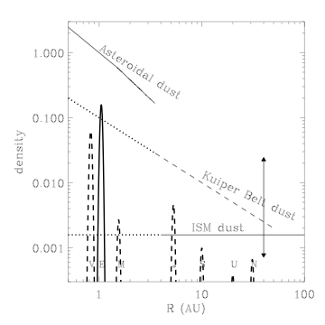
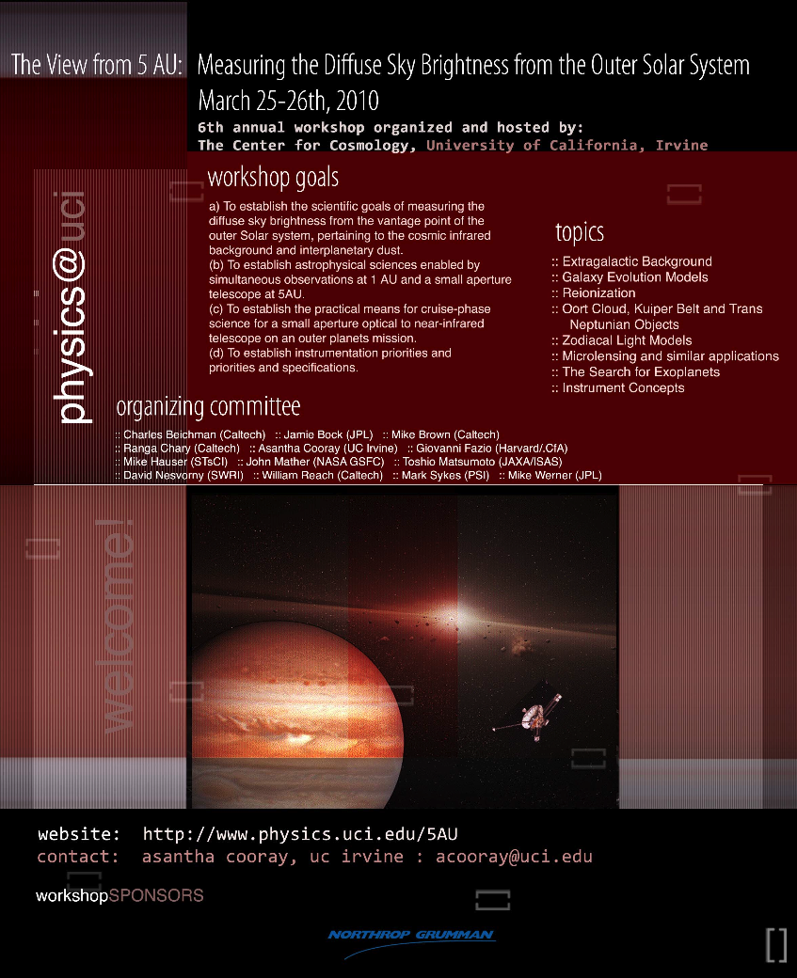
Outer
Zodiacal Light
Need to get beyond 5 AU
Next frontier
Collisional evolution of Kuiper Belt

Slide 25
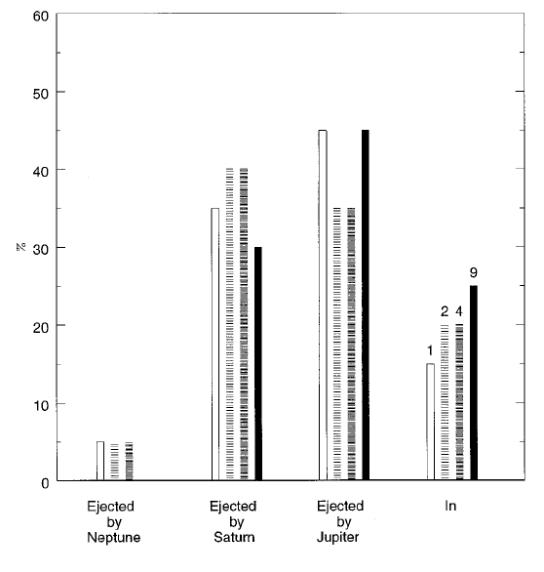
Kuiper Belt origin of Interplanetary Dust
Liou, Zook, & Dermott (1996)
Modeling dynamical evolution of grains from KBOs, including resonances and perturbations
Interstellar grain collisions are more rapid than mutual KB grain collisions
ISD may shatter KB particles >10 um before they reach the inner solar system

Slide 26
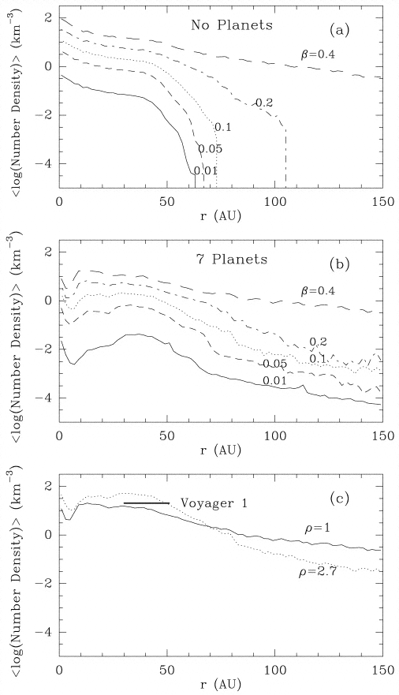
Dust Density predictions for Outer Solar System
Moro-Martin and Malhotra (2003)
Collisional production rate 10⁶-10⁸ g/s (Stern 1996, Landgraf 2002)
KB dust cloud mass ~ 10²²g
Relatively high eccentricities when passing Earth, like comets

Slide 27
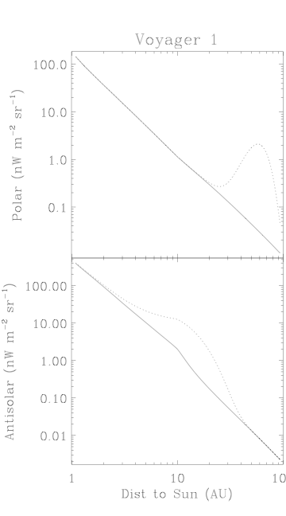
Zodiacal Light Predictions for spaceprobe
Use the Voyager 1 spacecraft trajectory (as an example)
    ecliptic pole
    antisolar direction
Illustrative calculation: power-law zodiacal cloud extrapolation, plus gaussian torus at Kuiper Belt

Slide 28
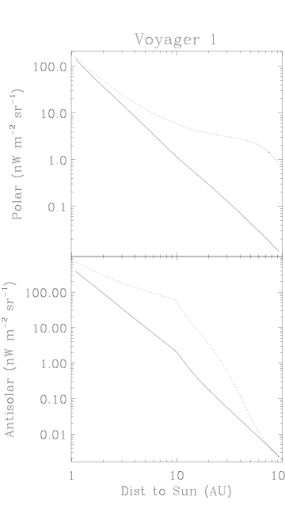
Outer Zodiacal Light: radial profile
Same as previous slide, but:
  Density estimate from Jewitt & Luu and Moro-Martin & Malhotra.
  Much wider distribution of KB dust (spiraling inward due to PR drag)

Slide 29
Planetary System Architecture
Under the Nice Model, giant planet mutual gravitational interactions violently perturbed shape of the outer solar system
Shape of Kuiper Belt and scattered disk population relate to past history of perturbations
KB dust relates to collision rate in the KB, as do asteroidal dust bands in the inner zodiacal light

Slide 30
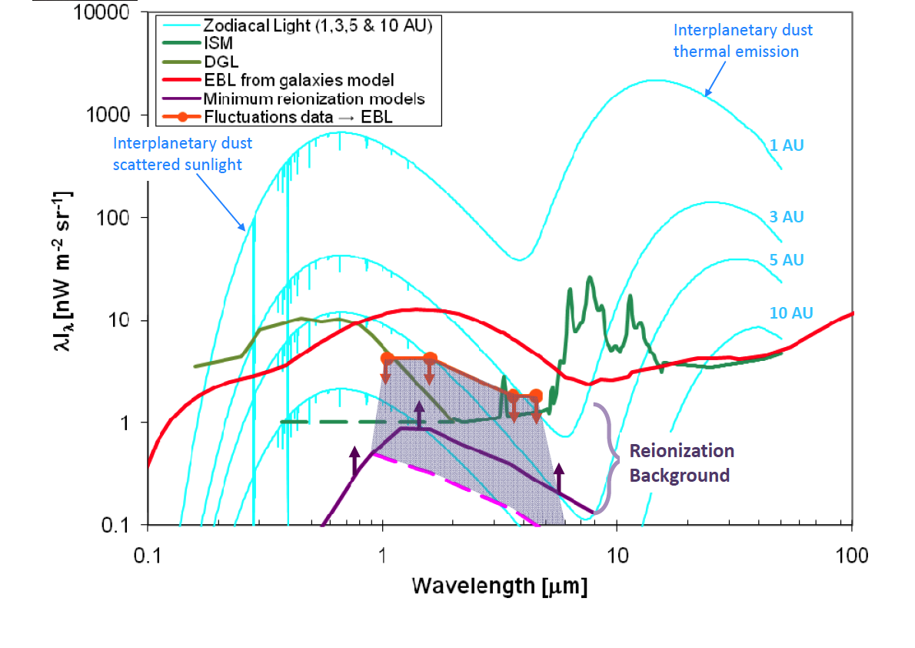
Tagalong science

Slide 31
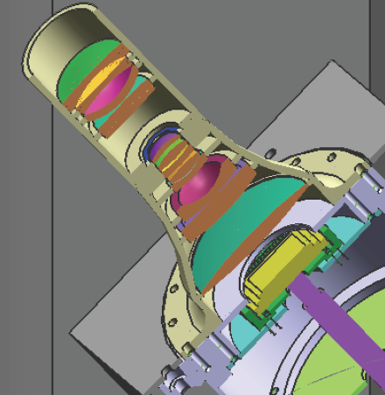
Wide-Field Camera
Refracting Optics
2 cm
Specifications
Spatial resolution: 5' x 5' pixels Wavelength band: 800 nm
Field of view: 85º x 85º Sensitivity: < 0.1 nW/m² sr per pixel
Focal plane: 1024² HAWAII 1.7 um HgCdTe or HiViSi
Science
● Kuiper belt cloud structure ● Interplanetary dust cloud structure

Slide 32
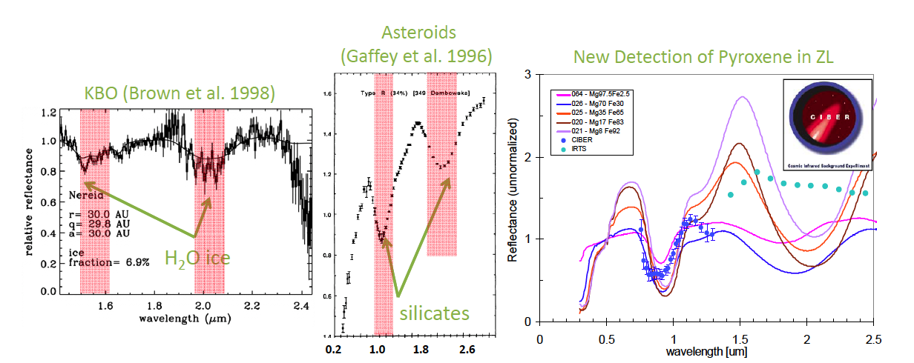
Composition of IDPs
Infrared spectra measure mineralogy of parent bodies
Comeplement laboratory work on IDPs and STARDUST

Slide 33
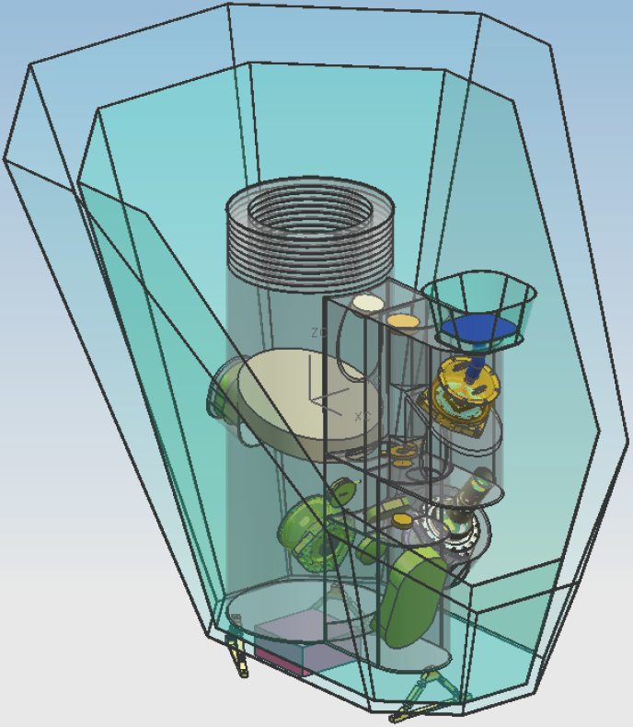
Sunshield1
teflon film
Sunshield2
kapton film
65 K Optical
Bench
40 K Radiator
(5 um FPA only)
15 cm Off-Axis
Cassegrain
(ala DIRBE)
Field Stop
Cold Shutters
Lyot Stops
Electronics box
JJB/13
Bipods to S/C
JPL Proprietary

